Slide 1


Data Science Capstone
Project
Bahareh Ahmadzadeh 07/14/2023

Slide 2

Outline
Executive Summary
Introduction
Methodology
Results
Conclusion
Appendix

Slide 3
Executive Summary
Data gathered from the SpaceX Wikipedia page and open SpaceX API. Labels column 'class' was created to categorise successful landings. used SQL, visualisation, folium maps, and dashboards to explore the data. compiled pertinent columns for use as features. used a single hot encoding to convert all categorical variables to binary. GridSearchCV was used to discover the ideal parameters for machine learning models using standardised data. Display the accuracy rating for each model.
Logistic Regression, Support Vector Machine, Decision Tree Classifier, and K Nearest Neighbours are the four machine learning models that were created. All gave identical results, with an average accuracy percentage of 83.33%. Successful landings were anticipated by all models. For improved model determination and accuracy, more data is required.

Slide 4
Introduction
Project background and context:
It's the Commercial Space Age now.
The most affordable option is Space X ($62 million vs. $165 million USD).
mostly because of the rocket's ability to be recovered (Stage 1)
Space Y aspires to rival Space X.
Problems you want to find answers:
We have been given the task by Space Y to develop a machine learning model that can forecast successful Stage 1 recovery.

Slide 5

Section 1

Slide 6
Methodology
Executive Summary
Data collection methodology:
Data was compiled using the SpaceX Wikipedia page and the public SpaceX API.
Perform data wrangling
Perform data manipulation by identifying successful and unsuccessful true landings
Perform exploratory data analysis (EDA) using visualization and SQL
Perform interactive visual analytics using Folium and Plotly Dash
Perform predictive analysis using classification models
Using classification models, perform predictive analysis: tuned models with GridSearchCV.

Slide 7
Data Collection
A combination of API queries from Space X's public API and web scraping data from a table in Space X's Wikipedia entry were used in the data collection procedure.
The flowchart for data collection from an API is shown on the following slide, and the flowchart for data collection via web scraping is shown on the slide after that.
Wikipedia Webscrape Data Columns: Flight No., Launch site, Payload, PayloadMass, Orbit, Customer, Launch outcome, Version Booster, Booster landing, Date, Time
Space X API Data Columns: FlightNumber, Date, BoosterVersion, PayloadMass, Orbit, LaunchSite, Outcome, Flights, GridFins, Reused, Legs, LandingPad, Block, ReusedCount, Serial, Longitude, Latitude.

Slide 8
Data Collection – SpaceX API
Data collection with SpaceX REST
GitHub URL of the completed SpaceX API:
https://github.com/BaharehAhz/IBM-Capston-Gitfiles/blob/master/week1/Data%20Collection%20API.ipynb
Request (Space X APIs)
Dictionary relevant data
Cast dictionary to a DataFrame
Filter data to only include Falcon 9 launches
Imputate missing PayloadMass values with mean
.JSON file + Lists(Launch Site, Booster Version, Payload Data)
Json_normalize to DataFrame data from JSON

Slide 9
Data Collection - Scraping
Web scraping process
Request Wikipedia
html
Create dictionary
Iterate through table cells to extract data to dictionary
Cast dictionary to DataFrame
BeautifulSoup
html5lib Parser
Find launch info html table
GitHub URL of the completed web scraping notebook:
https://github.com/BaharehAhz/IBM-Capston-Gitfiles/blob/master/week1/Data%20Collection%20with%20Web%20Scraping.ipynb

Slide 10
Data Wrangling
Training label with landing outcomes: successful = 1 , failure = 0.
Outcome column: ‘Mission Outcome’, ‘Landing Location’
New training label ‘class’: 1 if ‘Mission Outcome’ is True and 0 otherwise.
True ASDS, True RTLS, & True Ocean – set to -> 1
None None, False ASDS, None ASDS, False Ocean, False RTLS – set to -> 0
GitHub URL:
https://github.com/BaharehAhz/IBM-Capston-Gitfiles/blob/master/week1/Data%20wrangling.ipynb

Slide 11
EDA with Data Visualization
Exploratory Data Analysis performed on variables Flight Number, Payload Mass, Launch Site, Orbit, Class, and Year.
In order to determine whether a relationship between two variables exists so that it may be used in training the machine learning model, relationships between variables were compared using scatter plots, line charts, and bar plots.
Plot for Flight Number vs. Payload Mass, Flight Number vs. Launch Site, Payload Mass vs. Launch Site, Orbit vs. Success Rate, Flight Number vs. Orbit, Payload vs Orbit, and Success Yearly Trend
GitHub URL:
https://github.com/BaharehAhz/IBM-Capston-Gitfiles/blob/master/week2/jupyter-labs-eda-dataviz.ipynb

Slide 12
EDA with SQL
loaded IBM DB2 Database with a data set.
Using SQL Python integration to query.
To understand the dataset better, queries were run.
Asked for details on launch site names, mission results, different customer and booster payload amounts, and landing results.
GitHub URL:
https://github.com/BaharehAhz/IBM-Capston-Gitfiles/blob/master/week2/jupyter-labs-eda-sql-coursera_sqllite.ipynb

Slide 13
Build an Interactive Map with Folium
Launch sites, successful and unsuccessful landings, and examples of important destinations that are close by are marked on folium maps, including railways, highways, coasts, and cities.
This enables us to comprehend potential reasons for the positioning of launch sites. visualizes successful landings in relation to their location as well.
GitHub URL:
https://github.com/BaharehAhz/IBM-Capston-Gitfiles/blob/master/week3/lab_jupyter_launch_site_location.ipynb

Slide 14
Build a Dashboard with Plotly Dash
Dashboard has a scatter plot and a pie chart.
Pie charts can be chosen to display the distribution of successful landings among all launch locations as well as the success rates of individual launch sites.
The payload mass on a slider between 0 and 10,000 kg, and either all sites or a specific site, are the two inputs for the scatter plot.
The success rate of the launch site is displayed via a pie chart.
We can examine how success varies among launch sites, payload tonnage, and booster version categories using the scatter plot.
GitHub URL:
https://github.com/BaharehAhz/IBM-Capston-Gitfiles/blob/master/week3/Dashboard.ipynb

Slide 15
Predictive Analysis (Classification)
Model development process
GitHub URL:
Split label column ‘Class’ from dataset
GridSearchCV (cv=10) to find optimal parameters
Use GridSearchCV on LogReg, SVM, Decision Tree, and KNN models
Score models on split test set
Fit and Transform Features using Standard Scaler
Train_test_split data
Confusion Matrix for all models
Barplot to compare scores of models

Slide 16
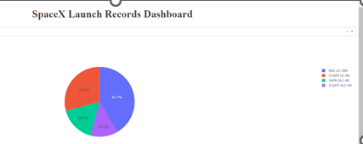
Results
The Plotly dashboard preview is shown here. The results of EDA with visualization, EDA with SQL, Interactive Map with Folium, and finally the outcomes of our model with an approximate 83% accuracy are displayed on the following sides.

Slide 17

EXPLORATORY DATA ANALYSIS WITH SEABORN PLOTS
EDA Visualization

Slide 18
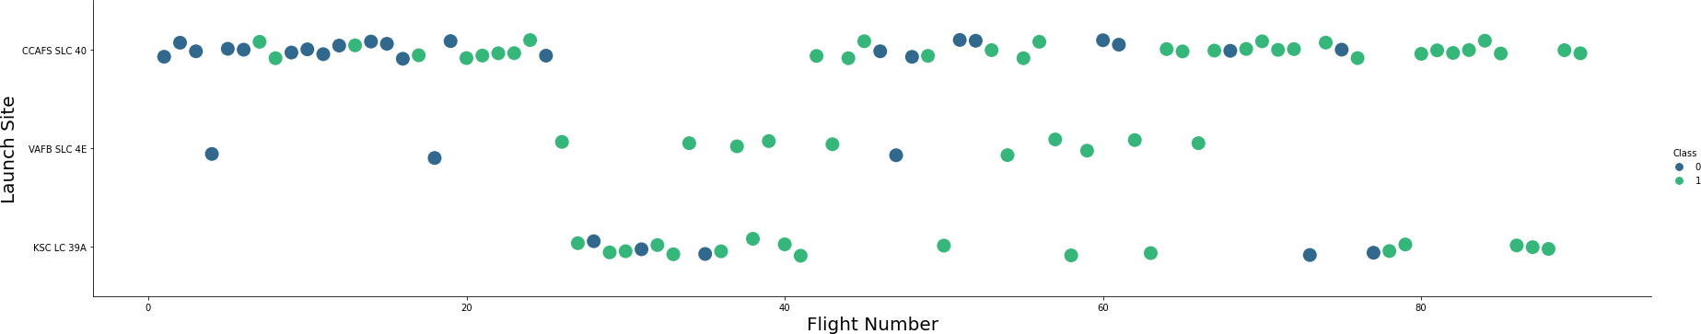
Flight Number vs. Launch Site
Green points denote successful launch and Purple indicates failed launch.
Graphic demonstrates an increase in success rate over time (shown in Flight Number). There was probably a huge advancement around Flight 20, which greatly raised the success rate. CCAFS looks to be the main launch point as it has the largest volume.

Slide 19
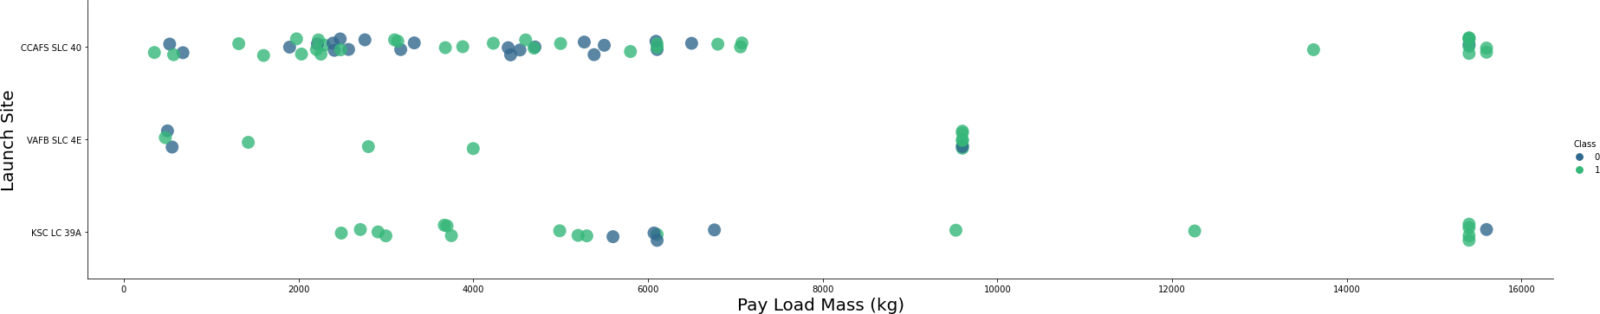
Payload vs. Launch Site
Green points denote successful launch and Purple indicates failed launch.
Payload mass appears to fall largely between 0-6000 kg. varying launch sites also seem to use varying payload mass.

Slide 20
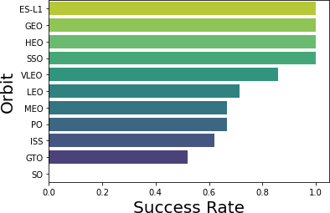
Success Rate vs. Orbit Type
ES-L1 (1), GEO (1), HEO (1) have 100% success rate (sample sizes in parenthesis)
SSO (5) has a 100% success rate
VLEO (14) has a decent success rate and attempts
SO (1) has a 0% success rate
GTO (27) has around 50% success rate but the largest sample
Success Rate Scale with
0 as 0%
0.6 as 60%
1 as 100%

Slide 21
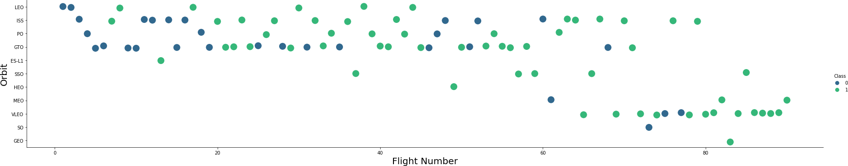
Flight Number vs. Orbit Type
Launches that are successful are shown in green, whereas failures are shown in purple.
Flight Number was preferred over Launch Orbit. This preference appears to be correlated with Launch Outcome.
SpaceX started with LEO orbits which experienced considerable success In recent launches, LEO and VLEO were switched. It seems that SpaceX performs better in lower or Sun-synchronous orbits.

Slide 22
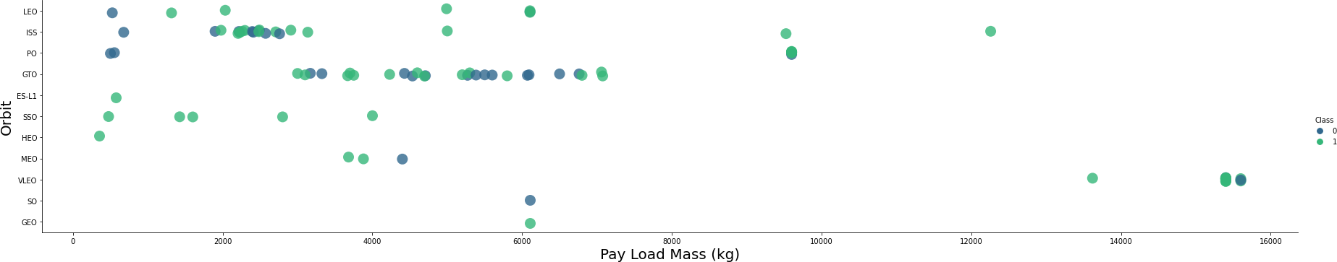
Payload vs. Orbit Type
Launches that are successful are shown in green, whereas failures are shown in purple.
Payload mass and orbit appear to be correlated, with LEO and SSO having relatively modest payload masses. Only payload mass values at the upper end of the range are available for the other most successful orbit VLEO.

Slide 23
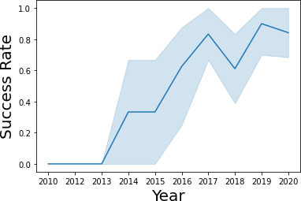
Launch Success Yearly Trend
Since 2013, success has typically increased with a little decline in 2018. Success has been about 80% in recent years.
95% confidence interval (light blue shading)

Slide 24
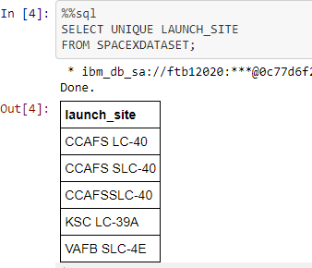
All Launch Site Names
EDA with SQL: EXPLORATORY DATA ANALYSIS WITH SQL DB2 INTEGRATED IN PYTHON WITH SQLALCHEMY
Query unique launch site names from database.
CCAFS SLC-40 and CCAFSSLC-40 likely all represent the same
launch site with data entry errors.
CCAFS LC-40 was the previous name. Likely only 3 unique launch_site values: CCAFS SLC-40, KSC LC-39A, VAFB SLC-4E

Slide 25
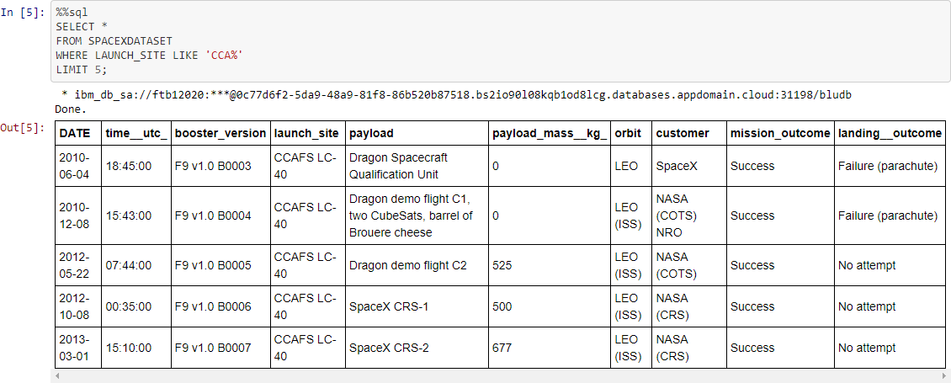
Launch Site Names Begin with 'CCA'
The first five records in the database have Launch Site names that start with CCA.

Slide 26
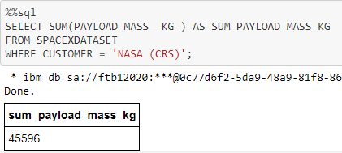
Total Payload Mass
When NASA was the customer, this query adds up the total payload mass in kilograms.
These payloads were delivered to the International Space Station (ISS), which is known by the abbreviation CRS.

Slide 27
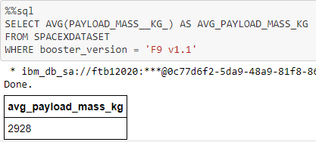
Average Payload Mass by F9 v1.1
The average payload mass for launches using the booster version F9 v1.1 is determined by this query. The average payload mass of F9 v1.1 is at the low end of our payload mass range.

Slide 28
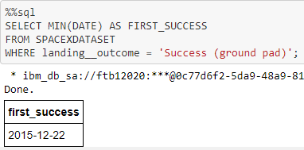
First Successful Ground Landing Date
The first successful ground pad landing date is returned by this query.
It took till the end of 2015 for the initial ground pad landing.
In general, successful landings start to occur in 2014.

Slide 29
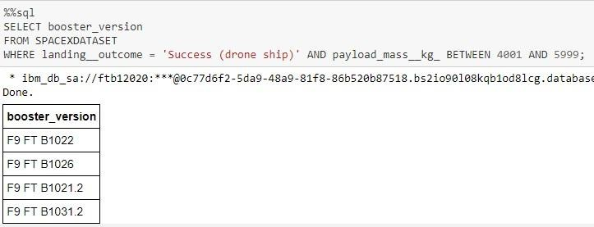
Successful Drone Ship Landing with Payload between 4000 and 6000
The four booster types with successful drone ship landings and a payload mass between 4,000 and 6,000 are returned by this search.

Slide 30
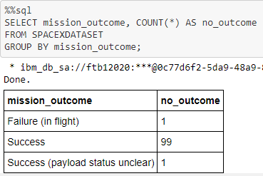
Total Number of Successful and Failure Mission Outcomes
This search yields a count of each mission result. It seems like SpaceX completes its missions almost 99% of the time.
This indicates that the majority of landing mishaps are deliberate. Interestingly, one launch's payload status is unknown, and regrettably, one launch failed in flight.

Slide 31
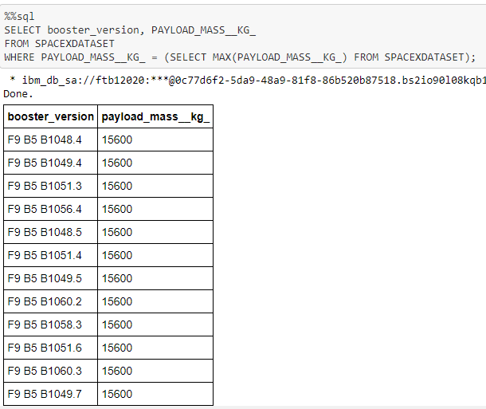
Boosters Carried Maximum Payload
The results of this search are the booster iterations that could lift a payload of up to 15600 kg. These booster variants are all of the F9 B5 B10xx.x variety and are remarkably similar.
This suggests that the payload mass and the booster design are related.

Slide 32
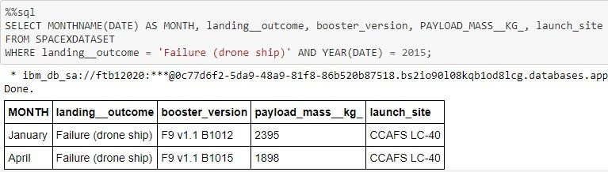
2015 Launch Records
The results of this search are the 2015 launches where stage 1 failed to land on a drone ship, along with the Month, Landing Outcome, Booster Version, Payload Mass (kg), and Launch Site. There were two instances like this.

Slide 33
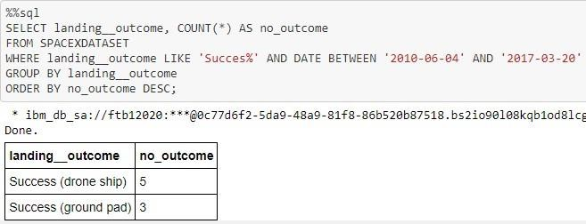
Rank Landing Outcomes Between 2010-06-04 and 2017-03-20
A list of successful landings between 2010-06-04 and 2017, inclusive, are returned by this query.
Drone ship landings and ground pad landings are the two different forms of successful landing results.
There were a total of 8 successful landings during this time.

Slide 34

Section 3

Slide 35

Launch Site Locations
The left map displays a relative US map with all launch sites. Due to their proximity, the two Florida launch sites are shown on the right map. Every launch place is close to the water.

Slide 36

Color-Coded Launch Markers
Clicking on clusters on the Folium map will show each successful (green icon) and unsuccessful (red symbol) landing. VAFB SLC-4E has 4 successful landings and 6 unsuccessful landings in this instance.

Slide 37



Key Location Proximities
For the most part and supply transportation, launch sites are located relatively close to railroads, using KSC LC-39A as an example. Highways for the transportation of people and supplies are around launch sites. In order to prevent rockets from falling on densely populated regions, launch locations are also located close to coasts and away from major towns.

Slide 38

Section 4

Slide 39


Successful Launches Across Launch Sites
This graph shows how successful landings have been distributed throughout all launch sites. The number of successful landings for CCAFS and KSC is equal, however the majority of them took place before to the name change because CCAFS LC-40 was the previous name for CCAFS SLC-40. The least number of successful landings occur at VAFB. This might be because the sample size was lower and launching was more challenging on the west coast.

Slide 40

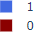
Highest Success Rate Launch Site
The most successful landings were made by KSC LC-39A, with 10 successful attempts and 3 unsuccessful ones.

Slide 41

Payload Mass vs. Success vs. Booster Version Category
Using the Payload range selector on the Plotly dashboard. However, instead of the maximum Payload of 15600, this is set from 0 to 10,000. Class displays 1 for a successful landing and 0 for an unsuccessful one. The booster version category in colour and the number of launches in point size are also taken into account by the scatter plot. It's noteworthy that there have been two failed landings in this specific range of 0-6000 with payloads of zero kilograms.

Slide 42

Section 5

Slide 43

Classification Accuracy
GRIDSEARCHCV(CV=10) ON LOGISTIC REGRESSION, SVM, DECISION TREE, AND KNN
On the test set, all models' accuracy was 83.33% or essentially the same. It should be emphasized that the sample size of 18 is a modest test size.
When a decision tree classifier model is used repeatedly, this can result in significant variance in accuracy outcomes.
To choose the optimal model, we probably require more information.

Slide 44

Confusion Matrix
The confusion matrix is the same for all models because their performance on the test set was identical. When the actual label was successful landing, the models projected 12 successful landings.
When the actual label was failure landing, the models projected three unsuccessful landings.
When the actual label was unsuccessful landings, the models incorrectly predicted three successful landings (false positives). Our forecasts overestimate the success of landings.
he diagonal of correct predictions runs from top left to bottom right.

Slide 45
Conclusions
Our job is to create a machine learning model that can forecast when Stage 1 will successfully land in order to save Space Y, which wants to compete against SpaceX, about $100 million USD.
Used information from the SpaceX Wikipedia page and a public SpaceX API.
Built a dashboard for visualization, created data labels, and added data to a DB2 SQL database.
Our machine-learning model had an 83% accuracy rate.
In order to decide whether or not to proceed with a launch, Allon Mask of SpaceY can use this model to forecast, with a fair amount of accuracy, if a launch will have a successful Stage 1 landing.
To improve accuracy and choose the optimum machine learning model, more data should ideally be gathered.

Slide 46
Appendix
Special Thanks to All Instructors
My GitHub repository URL:

Slide 47


